Slide 1
Module 17: Transactions

Slide 2
Outline
Transaction Concept
Transaction State
Concurrent Executions
Serializability
Recoverability
Implementation of Isolation
Transaction Definition in SQL
Testing for Serializability.

Slide 3
Transaction Concept
A transaction is a unit of program execution that accesses and possibly updates various data items.
E.g., transaction to transfer $50 from account A to account B:
1. read(A)
2. A := A – 50
3. write(A)
4. read(B)
5. B := B + 50
6. write(B)
Two main issues to deal with:
Failures of various kinds, such as hardware failures and system crashes
Concurrent execution of multiple transactions

Slide 4
Example of Fund Transfer
Transaction to transfer $50 from account A to account B:
1. read(A)
2. A := A – 50
3. write(A)
4. read(B)
5. B := B + 50
6. write(B)
Atomicity requirement
If the transaction fails after step 3 and before step 6, money will be “lost” leading to an inconsistent database state
Failure could be due to software or hardware
The system should ensure that updates of a partially executed transaction are not reflected in the database
Durability requirement — once the user has been notified that the transaction has completed (i.e., the transfer of the $50 has taken place), the updates to the database by the transaction must persist even if there are software or hardware failures.

Slide 5
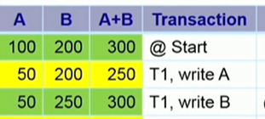
Example of Fund Transfer (Cont.)
Consistency requirement in above example:
The sum of A and B is unchanged by the execution of the transaction
In general, consistency requirements include
Explicitly specified integrity constraints such as primary keys and foreign keys
Implicit integrity constraints
e.g., sum of balances of all accounts, minus sum of loan amounts must equal value of cash-in-hand
A transaction must see a consistent database.
During transaction execution the database may be temporarily inconsistent.
When the transaction completes successfully the database must be consistent
Erroneous transaction logic can lead to inconsistency
1. read(A)
2. A := A – 50
3. write(A)
4. read(B)
5. B := B + 50
6. write(B)

Slide 6


Example of Fund Transfer (Cont.)
Isolation requirement — if between steps 3 and 6, another transaction T2 is allowed to access the partially updated database, it will see an inconsistent database (the sum A + B will be less than it should be).
- each transaction must be unaware of other concurrently executing transactions. Inter
T1 T2
1. read(A)
2. A := A – 50
3. write(A) read(A), read(B), print(A+B)
4. read(B)
5. B := B + 50
6. write(B
Isolation can be ensured trivially by running transactions serially
That is, one after the other.
However, executing multiple transactions concurrently has significant benefits, as we will see later.

Slide 7
ACID Properties
A transaction is a unit of program execution that accesses and possibly updates various data items. To preserve the integrity of data the database system must ensure:
Atomicity. Either all operations of the transaction are properly reflected in the database or none are.
Consistency. Execution of a transaction in isolation preserves the consistency of the database.
Isolation. Although multiple transactions may execute concurrently, each transaction must be unaware of other concurrently executing transactions. Intermediate transaction results must be hidden from other concurrently executed transactions.
That is, for every pair of transactions T_{i} and T_{j}, it appears to T_{i} that either T_{j}, finished execution before T_{i} started, or T_{j} started execution after T_{i} finished.
Durability. After a transaction completes successfully, the changes it has made to the database persist, even if there are system failures.

Slide 8

Transaction State
Active – the initial state; the transaction stays in this state while it is executing
Partially committed – after the final statement has been executed.
Failed -- after the discovery that normal execution can no longer proceed.
Aborted – after the transaction has been rolled back and the database restored to its state prior to the start of the transaction. Two options after it has been aborted:
Restart the transaction
Can be done only if no internal logical error
Kill the transaction
Committed – after successful completion.
1. read(A)
2. A := A – 50
3. write(A)
4. read(B)
5. B := B + 50
6. write(B)

Slide 9
Transaction State (Cont.)

Slide 10
Concurrent Executions
Multiple transactions are allowed to run concurrently in the system. Advantages are:
Increased processor and disk utilization, leading to better transaction throughput
E.g., one transaction can be using the CPU while another is reading from or writing to the disk
Reduced average response time for transactions: short transactions need not wait behind long ones.
Concurrency control schemes – mechanisms to achieve isolation
That is, to control the interaction among the concurrent transactions in order to prevent them from destroying the consistency of the database
Locking
Time Stamps
Will study in Chapter 15, after studying notion of correctness of concurrent executions.

Slide 11
Schedules
Schedule – a sequences of instructions that specify the chronological order in which instructions of concurrent transactions are executed
A schedule for a set of transactions must consist of all instructions of those transactions
Must preserve the order in which the instructions appear in each individual transaction.
A transaction that successfully completes its execution will have a commit instructions as the last statement
By default transaction assumed to execute commit instruction as its last step
A transaction that fails to successfully complete its execution will have an abort instruction as the last statement

Slide 12
Schedule 1
Let T₁ transfer $50 from A to B, and T₂ transfer 10% of the balance from A to B.
A serial schedule in which T₁ is followed by T₂ :

Slide 13
Schedule 2
A serial schedule where T₂ is followed by T₁

Slide 14
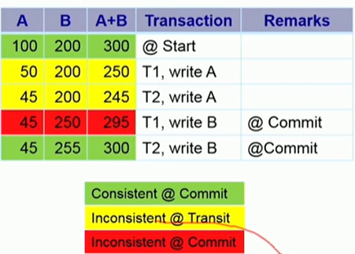
Schedule 3
Let T₁ and T₂ be the transactions defined previously. The following schedule is not a serial schedule, but it is equivalent to Schedule 1
In Schedules 1, 2 and 3, the sum A + B is preserved.
Schedules 3
Schedules 1
Notes:
Schedules 1

Slide 15
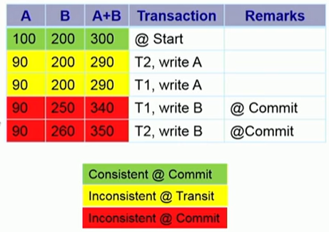
Schedule 4
The following concurrent schedule does not preserve the value of (A + B ).

Slide 16
Serializability
Basic Assumption – Each transaction preserves database consistency.
Thus, serial execution of a set of transactions preserves database consistency.
A (possibly concurrent) schedule is serializable if it is equivalent to a serial schedule. Different forms of schedule equivalence give rise to the notions of:
1. Conflict serializability
2. View serializability

Slide 17
Simplified view of transactions
We ignore operations other than read and write instructions
We assume that transactions may perform arbitrary computations on data in local buffers in between reads and writes.
Our simplified schedules consist of only read and write instructions.

Slide 18
Conflicting Instructions
Instructions l_{i} and l_{j} of transactions T_{i} and T_{j} respectively, conflict if and only if there exists some item Q accessed by both l_{i} and l_{j}, and at least one of these instructions wrote Q.
1. l_{i} = read(Q), l_{j} = read(Q). l_{i} and l_{j} don’t conflict. 2. l_{i} = read(Q), l_{j} = write(Q). They conflict. 3. l_{i} = write(Q), l_{j} = read(Q). They conflict 4. l_{i} = write(Q), l_{j} = write(Q). They conflict
Intuitively, a conflict between l_{i} and l_{j} forces a (logical) temporal order between them.
If l_{i} and l_{j} are consecutive in a schedule and they do not conflict, their results would remain the same even if they had been interchanged in the schedule.

Slide 19
Conflict Serializability
If a schedule S can be transformed into a schedule S’ by a series of swaps of non-conflicting instructions, we say that S and S’ are conflict equivalent.
We say that a schedule S is conflict serializable if it is conflict equivalent to a serial schedule

Slide 20
Conflict Serializability (Cont.)
Schedule 3 can be transformed into Schedule 6, a serial schedule where T₂ follows T₁, by series of swaps of non-conflicting instructions. Therefore Schedule 3 is conflict serializable.
Schedule 3
Schedule 6

Slide 21
Conflict Serializability (Cont.)
Example of a schedule that is not conflict serializable:
We are unable to swap instructions in the above schedule to obtain either the serial schedule < T₃, T₄ >, or the serial schedule < T₄, T₃ >.

Slide 22
View Serializability
Let S and S’ be two schedules with the same set of transactions. S and S’ are view equivalent if the following three conditions are met, for each data item Q,
1. If in schedule S, transaction T_{i} reads the initial value of Q, then in
schedule S’ also transaction T_{i} must read the initial value of Q.
2. If in schedule S transaction T_{i} executes read(Q), and that value was
produced by transaction T_{j} (if any), then in schedule S’ also
transaction T_{i} must read the value of Q that was produced by the
same write(Q) operation of transaction T_{j} .
3. The transaction (if any) that performs the final write(Q) operation in
schedule S must also perform the final write(Q) operation in schedule S’.
As can be seen, view equivalence is also based purely on reads and writes alone.

Slide 23
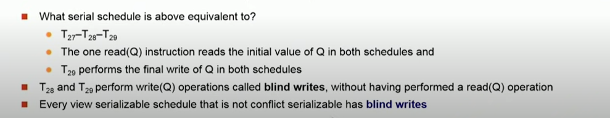
View Serializability (Cont.)
A schedule S is view serializable if it is view equivalent to a serial schedule.
Every conflict serializable schedule is also view serializable.
Below is a schedule which is view-serializable but not conflict serializable.
What serial schedule is above equivalent to?
Every view serializable schedule that is not conflict serializable has blind writes.
T27 | T28 | T29
Read(Q)
Write(Q)
 | Write(Q)
 |  | Write(Q)
Notes:
T27 28 w maaru karalada ?

Slide 24
Other Notions of Serializability
The schedule below produces same outcome as the serial schedule < T₁, T₅ >, yet is not conflict equivalent or view equivalent to it.
Determining such equivalence requires analysis of operations other than read and write.

Slide 25
Testing for Serializability
Consider some schedule of a set of transactions T₁, T₂, ..., T_{n}
Precedence graph — a direct graph where the vertices are the transactions (names).
We draw an arc from T_{i} to T_{j} if the two transaction conflict, and T_{i} accessed the data item on which the conflict arose earlier.
We may label the arc by the item that was accessed.
Example of a precedence graph
T1 | T2
R(A)
W(A)
 | R(B)
 | W(B)
R(B)
W(B)
 | R(A)
 | W(A)

Slide 26
Precedance graph
Class Activity 3
T1 | T2 | T3
R(A)
 | W(A)
 |  | W(A)
W(A)
T1 | T2 | T3
R(A)
 |  | R(C)
 |  | W©
 | R(B)
R(B)
 | W(B)
 |  | W(A)
 | W©
1 .Explain your own words what is conflict serializability.
2 . Construct the precedence graph for the schedule given above and show that this schedule is conflict serializable.
3. What serial schedule above equivalent to (if it is conflict serializable)

Slide 27
Recoverable Schedules
Need to address the effect of transaction failures on concurrently running transactions.
Recoverable schedule — if a transaction T_{j} reads a data item previously written by a transaction T_{i} , then the commit operation of T_{i} appears before the commit operation of T_{j}.
The following schedule (Schedule 11) is not recoverable
If T₈ should abort, T₉ would have read (and possibly shown to the user) an inconsistent database state. Hence, database must ensure that schedules are recoverable.
Notes:
T6 is still active state

Slide 28
Cascading Rollbacks
Cascading rollback – a single transaction failure leads to a series of transaction rollbacks. Consider the following schedule where none of the transactions has yet committed (so the schedule is recoverable) If T₁₀ fails, T₁₁ and T₁₂ must also be rolled back.
Can lead to the undoing of a significant amount of work

Slide 29
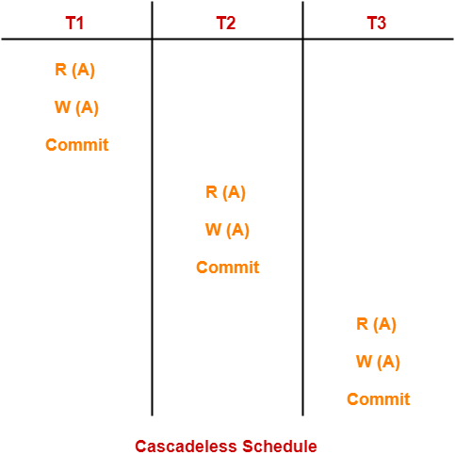
Cascadeless Schedules
Cascadeless schedules — cascading rollbacks cannot occur;
For each pair of transactions T_{i} and T_{j} such that T_{j} reads a data item previously written by T_{i}, the commit operation of T_{i} appears before the read operation of T_{j}.
Every Cascadeless schedule is also recoverable
It is desirable to restrict the schedules to those that are cascadeless

Slide 30
Concurrency Control
A database must provide a mechanism that will ensure that all possible schedules are
either conflict or view serializable, and
are recoverable and preferably cascadeless
A policy in which only one transaction can execute at a time generates serial schedules, but provides a poor degree of concurrency
Are serial schedules recoverable/cascadeless?
Testing a schedule for serializability after it has executed is a little too late!
Goal – to develop concurrency control protocols that will assure serializability.
Waiting time,response time,resourse utilization,efficiency
Inconsistency?

Slide 31
Concurrency Control (Cont.)
Schedules must be conflict or view serializable, and recoverable, for the sake of database consistency, and preferably cascadeless.
A policy in which only one transaction can execute at a time generates serial schedules, but provides a poor degree of concurrency.
Concurrency-control schemes tradeoff between the amount of concurrency they allow and the amount of overhead that they incur.
Some schemes allow only conflict-serializable schedules to be generated, while others allow view-serializable schedules that are not conflict-serializable.

Slide 32















Precedance graph
.
T1 | T2 | T3
R(A)
 | W(A)
 |  | W(A)
W(A)
T1 | T2 | T3
R(A)
 |  | R(C)
 |  | W©
 | R(B)
R(B)
 | W(B)
 |  | W(A)
 | W©

Slide 33
Concurrency Control vs. Serializability Tests
Concurrency-control protocols allow concurrent schedules, but ensure that the schedules are conflict/view serializable, and are recoverable and cascadeless .
Concurrency control protocols (generally) do not examine the precedence graph as it is being created
Instead a protocol imposes a discipline that avoids non-serializable schedules.
We study such protocols in Chapter 16.
Different concurrency control protocols provide different tradeoffs between the amount of concurrency they allow and the amount of overhead that they incur.
Tests for serializability help us understand why a concurrency control protocol is correct.
Table level concurrency control , row level concurrent access, - if one table is locked

Slide 34
Weak Levels of Consistency
Some applications are willing to live with weak levels of consistency, allowing schedules that are not serializable
E.g., a read-only transaction that wants to get an approximate total balance of all accounts
E.g., database statistics computed for query optimization can be approximate (why?)
Such transactions need not be serializable with respect to other transactions
Tradeoff accuracy for performance

Slide 35
Levels of Consistency in SQL-92
Serializable — default
Repeatable read — only committed records to be read. –
Repeated reads of same record must return same value.
However, a transaction may not be serializable – it may find some records inserted by a transaction but not find others.
Read committed — only committed records can be read.
Successive reads of record may return different (but committed) values.
Read uncommitted — even uncommitted records may be read.
No dirty writes allowed

Slide 36
Repeatable read
Let's consider two transactions, T1 and T2, operating in the Repeatable Read isolation level:
Transaction T1:
T1 begins and reads the quantity of laptops (ProductID 1), which is 10.
T1 performs some calculations based on the quantity but hasn't yet committed these calculations.
Transaction T2: 3. While T1 is still in progress, T2 begins and updates the quantity of laptops to 15.
T2 commits the update, making the new quantity 15.
Back to Transaction T1: 5. T1, still in progress, decides to re-read the quantity of laptops, assuming it's still 10.
According to the Repeatable Read isolation level, T1 should see the same data as it saw at the start of the transaction.
Thus, T1 still sees the old quantity (10) for laptops, even though T2 has committed the change to 15.

Slide 37
Read Committed
let's look at two transactions, T1 and T2, operating in the Read Committed isolation level:
Transaction T1:
T1 begins and reads all orders from the "Orders" table with an "OrderStatus" of "Processing."
It sees OrderID 1.
Transaction T2: 2. While T1 is still in progress, T2 begins and updates the OrderStatus
of OrderID 1 from "Processing" to "Shipped."
T2 commits the update, changing the status of OrderID 1 to "Shipped."
Back to Transaction T1: 4. T1, still in progress, decides to read all orders
from the "Orders" table with an "OrderStatus" of "Processing" again.
T1 no longer sees OrderID 1 because it has been updated and committed by T2.
it does not see the change made by T2. This ensures that dirty reads are prevented,
but it allows non-repeatable reads In this case, OrderID 1 is no longer visible to
T1 in its second query due to the update by T2.

Slide 38
Levels of Consistency
Lower degrees of consistency useful for gathering approximate information about the database
Warning: some database systems do not ensure serializable schedules by default
E.g., Oracle (and PostgreSQL prior to version 9) by default support a level of consistency called snapshot isolation (not part of the SQL standard)

Slide 39
Transaction Definition in SQL
In SQL, a transaction begins implicitly.
A transaction in SQL ends by:
Commit work commits current transaction and begins a new one.
Rollback work causes current transaction to abort.
In almost all database systems, by default, every SQL statement also commits implicitly if it executes successfully
Implicit commit can be turned off by a database directive
E.g., in JDBC -- connection.setAutoCommit(false);
Isolation level can be set at database level
Isolation level can be changed at start of transaction
E.g. In SQL set transaction isolation level serializable
E.g. in JDBC -- connection.setTransactionIsolation( Connection.TRANSACTION_SERIALIZABLE)

Slide 40
Implementation of Isolation Levels
Locking –serializability and performance
Lock on whole database vs lock on items
How long to hold lock?
Shared vs exclusive locks
Timestamps
Transaction timestamp assigned e.g. when a transaction begins
Data items store two timestamps
Read timestamp
Write timestamp
Timestamps are used to detect out of order accesses
Multiple versions of each data item
Allow transactions to read from a “snapshot” of the database

Slide 41
Transactions as SQL Statements
E.g., Transaction 1: select ID, name from instructor where salary > 90000
E.g., Transaction 2: insert into instructor values ('11111', 'James', 'Marketing', 100000)
Suppose
T1 starts, finds tuples salary > 90000 using index and locks them
And then T2 executes.
Do T1 and T2 conflict? Does tuple level locking detect the conflict?
Instance of the phantom phenomenon
Here, the order of (a) and (b) will result in different states of the database. This situation is known as ‘Phantom Phenomenon
Also consider T3 below, with Wu’s salary = 90000 update instructor set salary = salary * 1.1 where name = 'Wu’
Key idea: Detect “predicate” conflicts, and use some form of “predicate locking”

Slide 42
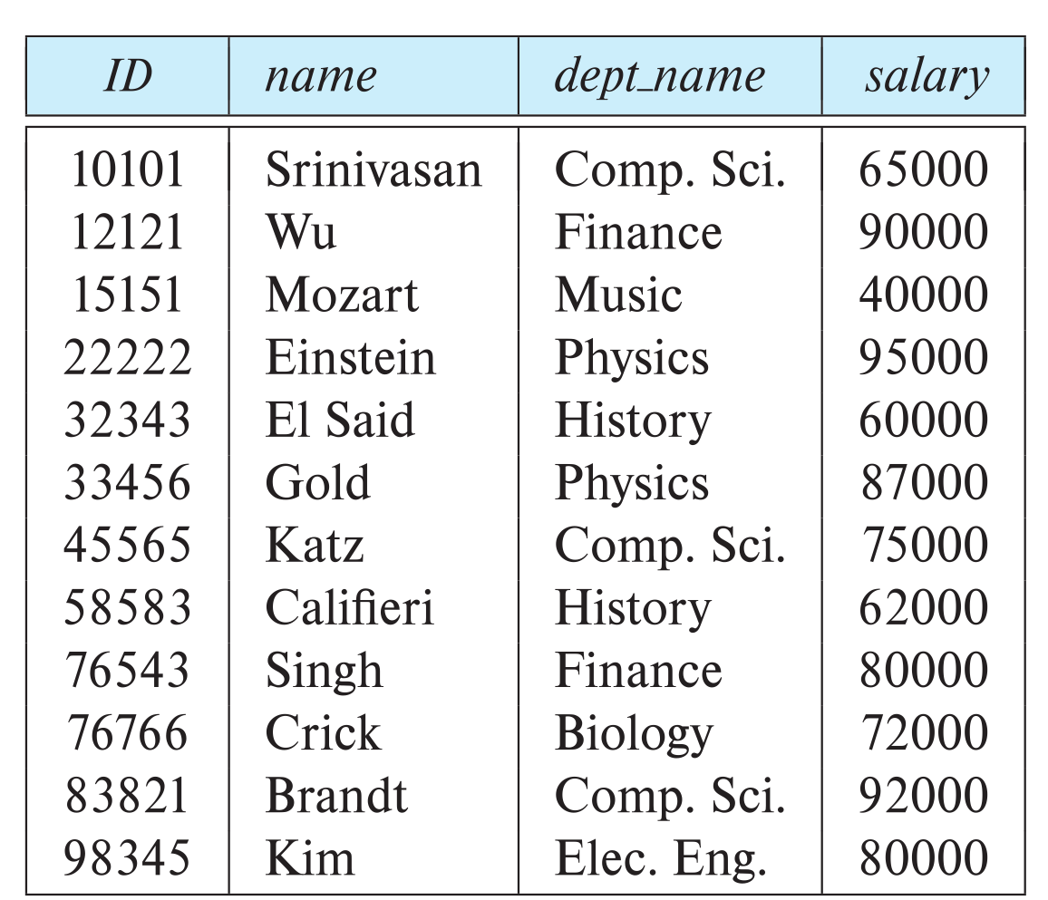

Slide 43
End of Chapter 17

